Slide 1
0_preproc_dataset

Slide 2
Requirement document
Onehot: come from 0_onehot_geome.py
GTF: come from 0_onehot_geome.py
Label: python 1_MAGIC.py
Annotation: modification

Slide 3

Step0
If it is compressed, uncompressed them first
Onehot

Slide 4
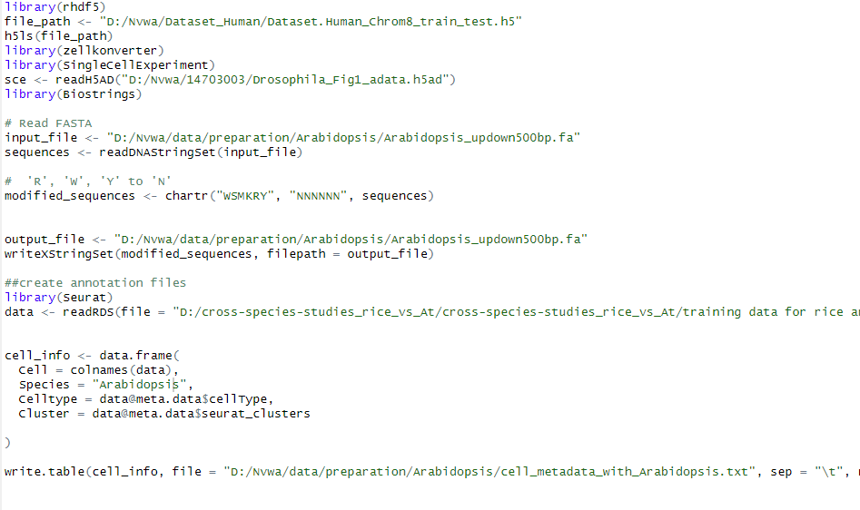
Modification file
Annotation file

Slide 5
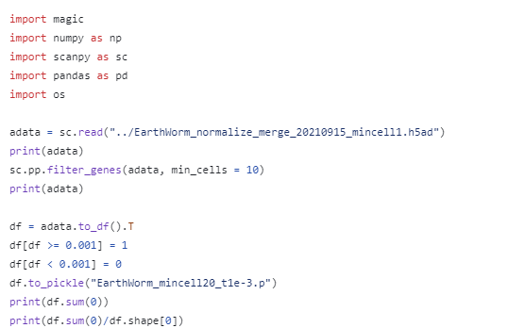
Step1
This is a normalized single cell data
Please don’t forgot change path
This is supposed to be label

Slide 6
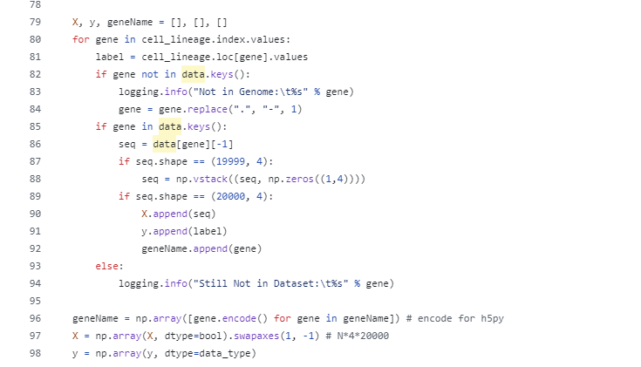
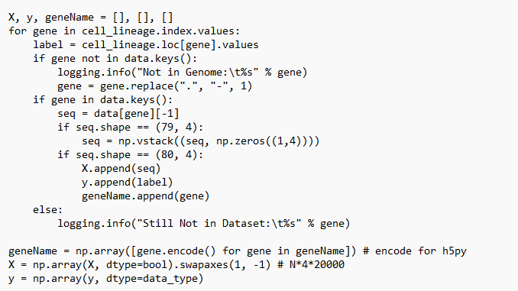
2_propare_datasets.py
It is the length of genome sequence.
For Arabidopsis, its length is 80

